Slide 1
Enterprise Network
ENTERPRISE NETWORK IMPLEMENTATION

Slide 2
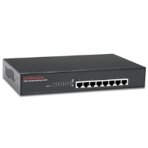

Small Office Network
Enterprise Network
Use Unmanaged 10/100 Switches
Use Enhanced Cat 5 Pathcords

Slide 3
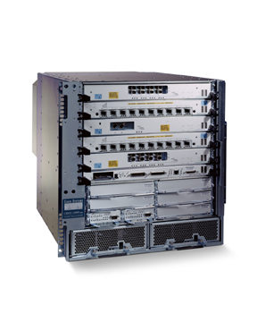


Campus Network Architecture
Enterprise Network
Server
Farm
Firewall
Backbone Switch
Internet
Distribution Switch
Access Switch

Slide 4
Campus Network Architecture
Enterprise Network
Uses Three Tier Switching Architecture (Popularly known as Cisco’s Switching Architecture)
Backbone Switch
  Layer 3/4 Chassis based switch
  Multiple 100Fx or 1000SX/LX or 10GLX/LH ports for connectivity to Distribution switches
  Multiple 10/100/1000 ports for connectivity to Servers
Distribution Switch
  Layer 2/3 Managed Fixed configuration switch
  1/2 100Fx or 1000Sx/Lx or 10GLX/LH ports for connectivity to the Backbone switch
  Multiple 10/100 or 10/100/1000 ports for connectivity to the Access switches
Access Switch
  Layer2 Managed/Unmanaged Fixed configuration switch
  Multiple 10/100 or 10/100/1000 ports for desktop connectivity

Slide 5

Campus Network Cabling
Enterprise Network
Campus backbone cabling—This is typically single- or multimode cable that interconnects the central campus Backbone Switch with each of the building Distribution Switches. Typically Ring Architecture is used to connect the Backbone switch to the Distribution switch to provide redundant routes.
Building backbone cabling—This is typically Category 5e or 6 UTP cable that interconnects the building distributor with each of the floor distributors in the building.
Horizontal cabling—This is predominantly Category 5e or 6 UTP cabling.

Slide 6
Distribution
Switch
Backbone
Switch
Distribution
Switch
Distribution
Switch

Slide 7
Distribution
Switch
Backbone
Switch
Distribution
Switch
Distribution
Switch

Slide 8
Distribution
Switch
Backbone
Switch
Distribution
Switch
Distribution
Switch

Slide 9
Campus Network
Enterprise Network
The residential connectivity can be provided on Ethernet/Dial-up/ADSL.
The Internet connectivity can be provided on leased line.

Slide 10
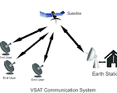
Enterprise WAN Architecture
Enterprise Network
A typical scenario will have Corporate Headquarter connected to Remote Offices (Branch Offices, Retail Counters etc.)
The Remote offices would be interconnected to the corporate office through
  A dedicated network implemented over Leased-Lines and/or IPLC (International Private Leased Circuit) (Microsoft, IBM, Cisco, Infosys etc.)
  A dedicated network implemented over VSAT (Banks’ ATM Network, Reserve Bank network, BSE Online Trading, NSE Online Trading etc.)
  VPNs on the Internet (Asian Paint Supplier Network, Bajaj Auto Retail Network etc.)
  A mix of above technologies
The backup links may provided through
  Redundant route through an alternate leased line
  Dial backup on ISDN (The Head Office has a PRI connectivity and the Remote offices have BRI connectivity)

Slide 11
Enterprise WAN Architecture
Enterprise Network
The Disaster Recovery site would be connected through multiple links to the main site
VoIP infrastructure may be available (A Call Manager will be placed at the Head Office and VoIP phones would be available in all the offices)
The NOC (Network Operation Center) may be at the Head Quarter (Infosys) or at a remote site (Reliance, Microsoft)
The NOC maintains, monitors and manages the network and application servers.
The Data exchange between offices may be through the servers at NOC to ensure security

Slide 12
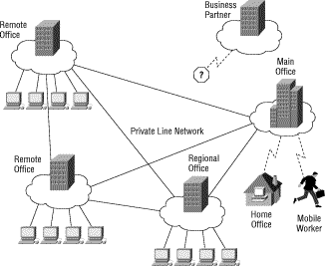
Enterprise WAN Network
Enterprise Network

Slide 13
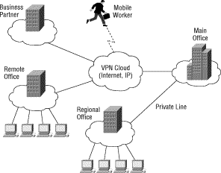
Enterprise WAN Network
Enterprise Network

Slide 14
Enterprise WAN
Enterprise Network
Server
Farm
Corporate Head Office
Branch Office
Service Provider
Network
Branch Office
All the locations are connected through a Service Provider Network
over MPLS Backbone (Multiprotocol Label Switching)
Branch Office

Slide 15
Service Provider Networks: Reliance
Enterprise Network
Reliance Data Centers, are connected to 132 countries across 4 continents spanning US, UK, Mid-east and Asia-Pac through Flag Telecom backbone (Reliance Infocomm 's group company) and other undersea cable systems like Se-Me-Wea-3 and i2i and are having public / private peering relationship with large Tier 1 ISPs and content providers at more than 15 Internet Exchange points across the globe. There also exists peering relationship with other popular domestic ISPs on STM-1 bandwidth levels.
The data centers further are connected to Reliance's country wide optic fiber based IP network with terabytes of capacity having points of presence at more than 1100 cities. Customers' can access the Internet by connecting to any of these 1100 PoPs using multiple means like local dedicated leased lines, PSTN -ISDN dialup links OR simply by using Reliance's 3G CDMA mobile services.
The Reliance Data Centers at various locations are also interconnected through redundant fiber ring with bandwidth capacity of STM-4 for data replication purposes for providing Disaster Recovery services.

Slide 16
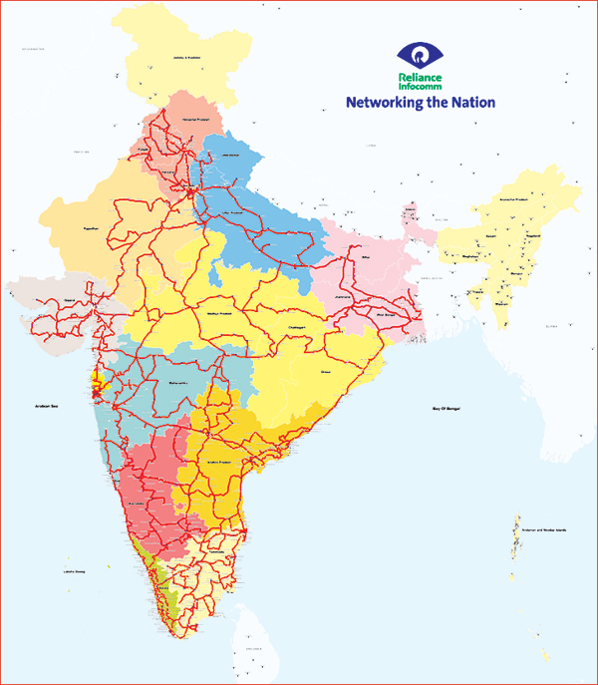
Service Provider Networks: Reliance
Enterprise Network

Slide 17
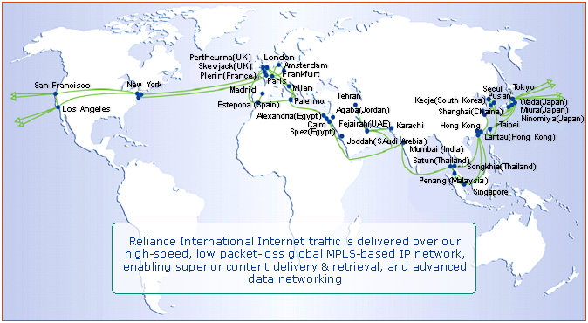
Service Provider Networks: Reliance
Enterprise Network

Slide 18
Service Provider Networks
Enterprise Network
ISP network
ISP network
Backbone
networks
Bandwidth-limited
links
ISP
network
Customers connect to an ISP
ISPs connect to backbone
Customer Networks

Slide 19
Service Provider Networks: FLAG
Enterprise Network
http://www.flagtelecom.com/Global_network.swf

